Slide 1
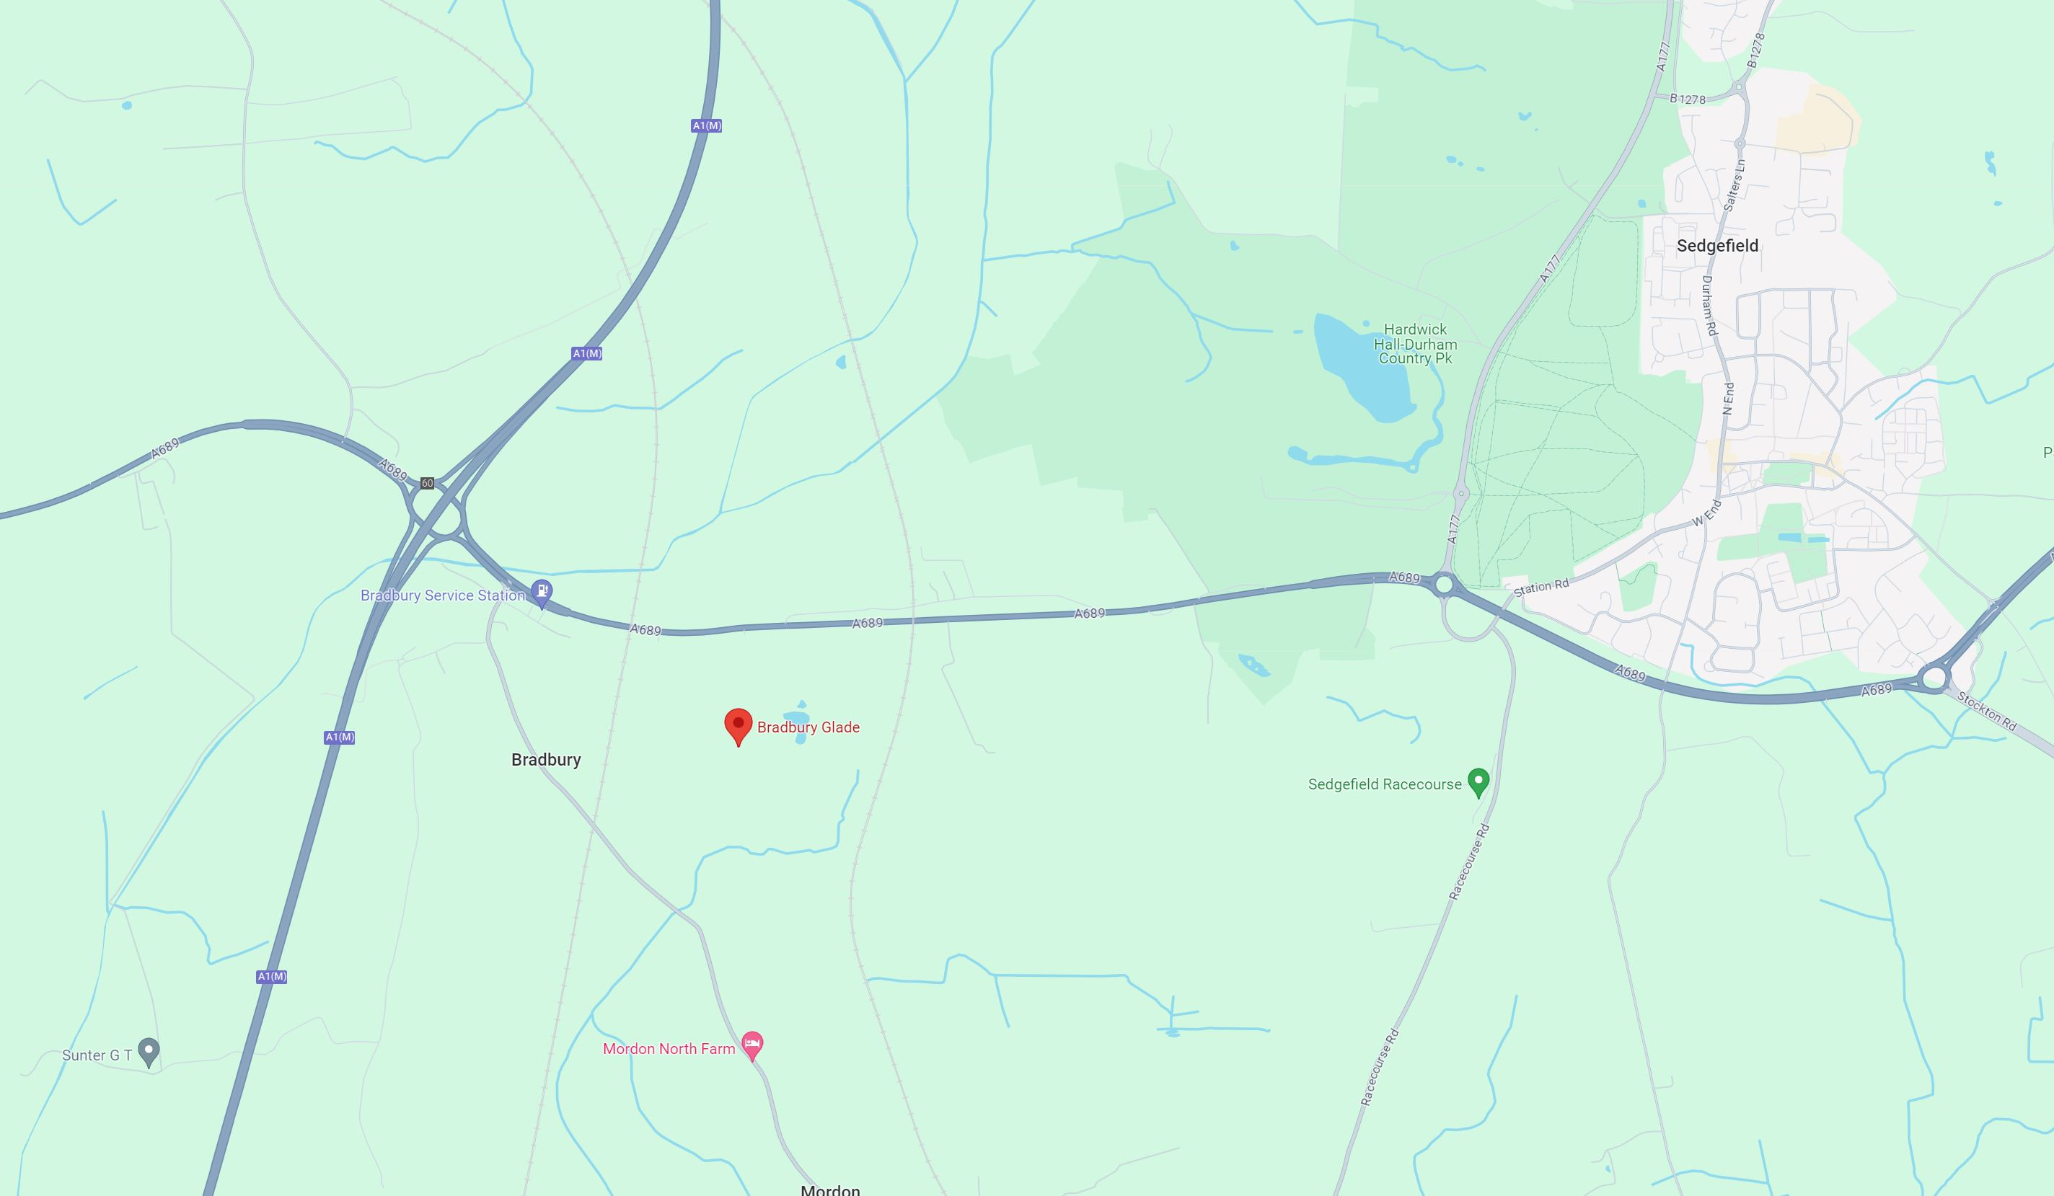
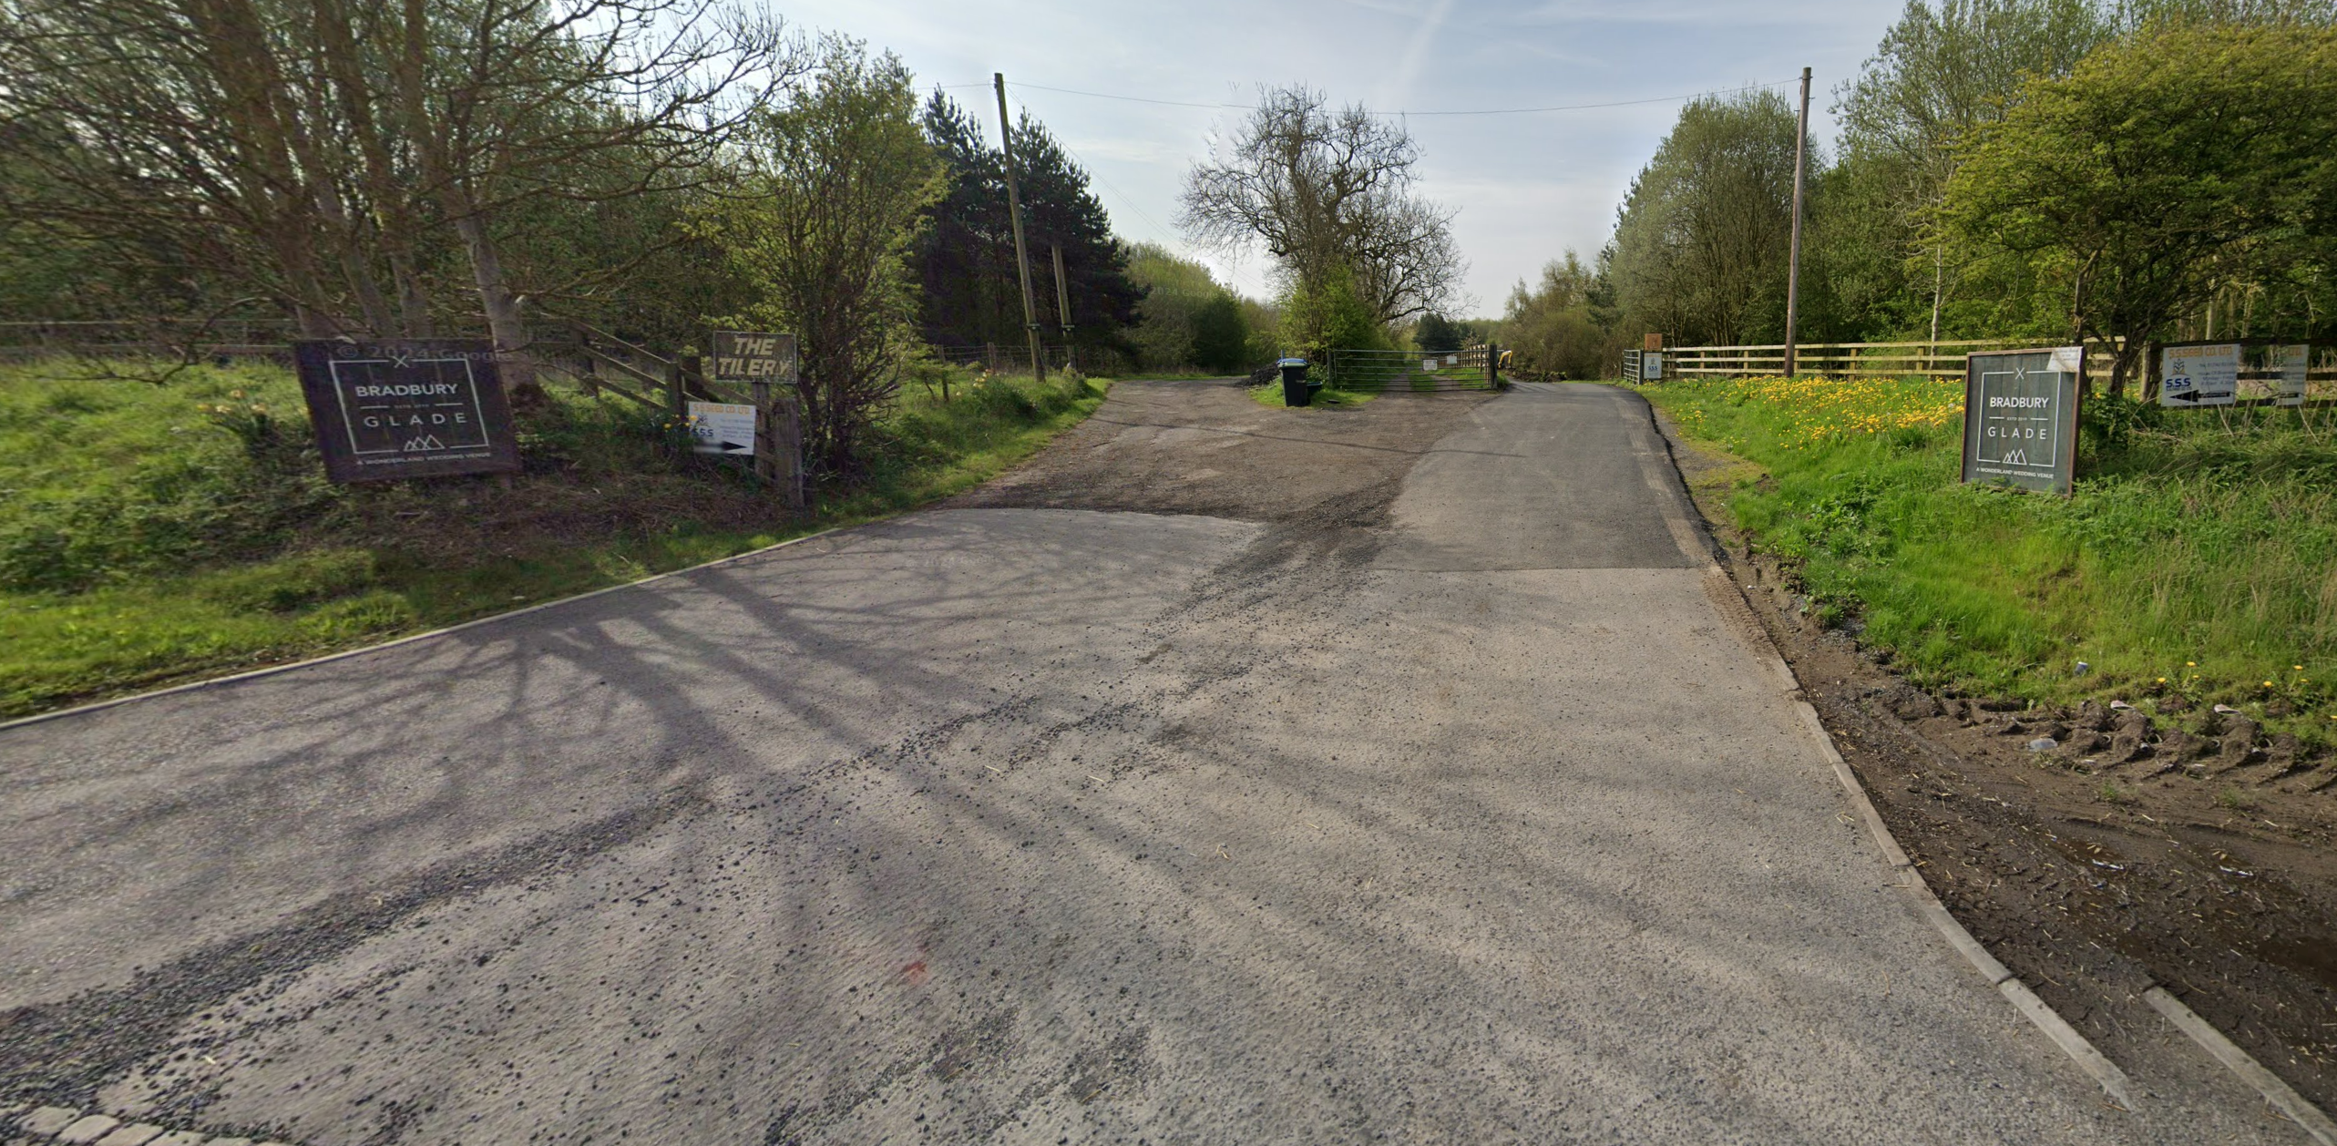
From A1 (North)
Access off A689
From A689 (East)
Use right-hand track
From A1 (South)

